Slide 1

Engineering Chemistry(CHY1001)
B.Tech. (Chemistry Cycle)
Module-1
Faculty of Science, Technology and Architecture
School of Physical and Biological Sciences
Department of Chemistry
Manipal University Jaipur

Slide 2

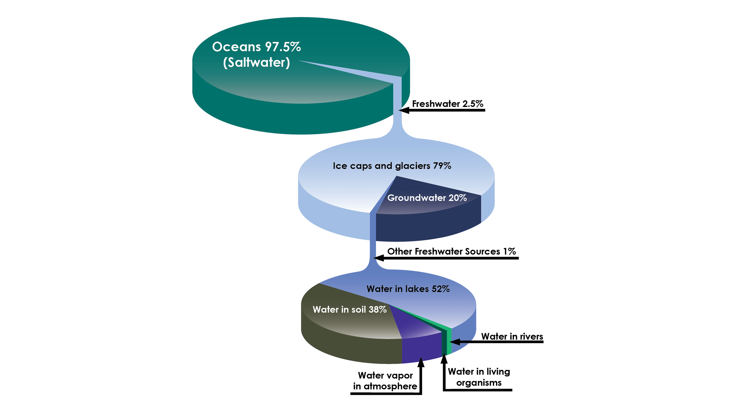
The water resource

Slide 3
HARDNESS OF WATER
Soft Water
The soft water when treated with soap produces more lather and consume less soap and this is due to the absence of dissolved salts of Ca & Mg in water.
C₁₇H₃₅ COONa + H₂O NaOH + 2C₁₇H₃₅ COOH
Example: Rain water, Distilled water, Demineralized water

Slide 4
HARDNESS OF WATER
Hard Water
Contains bicarbonates, chlorides and sulphates of calcium & magnesium.
Does not produce good lather or foam with soap.
Consume more soap [The soap consists of sodium salts of fatty acids such as Oleic acid, Palmitic acid and stearic acid. Calcium and magnesium react with the sodium salts of long chain fatty acid present in the soap to form insoluble scums of calcium and magnesium soaps]
Other metal ions such as Fe²⁺, Mn²⁺, Al³⁺ also contributing to hardness, but they are present in water only in traces

Slide 5
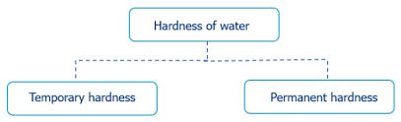
Hardness of water
(1) Temporary Hardness
Calcium Bicarbonate Ca(HCO₃)₂
Magnesium Bicarbonate Mg(HCO₃)₂
(2) Permanent Hardness
Calcium Chloride (CaCl₂)
Magnesium Chloride (MgCl₂)
Calcium Sulphate (CaSO₄)
Magnesium Sulphate (MgSO₄)

Slide 6
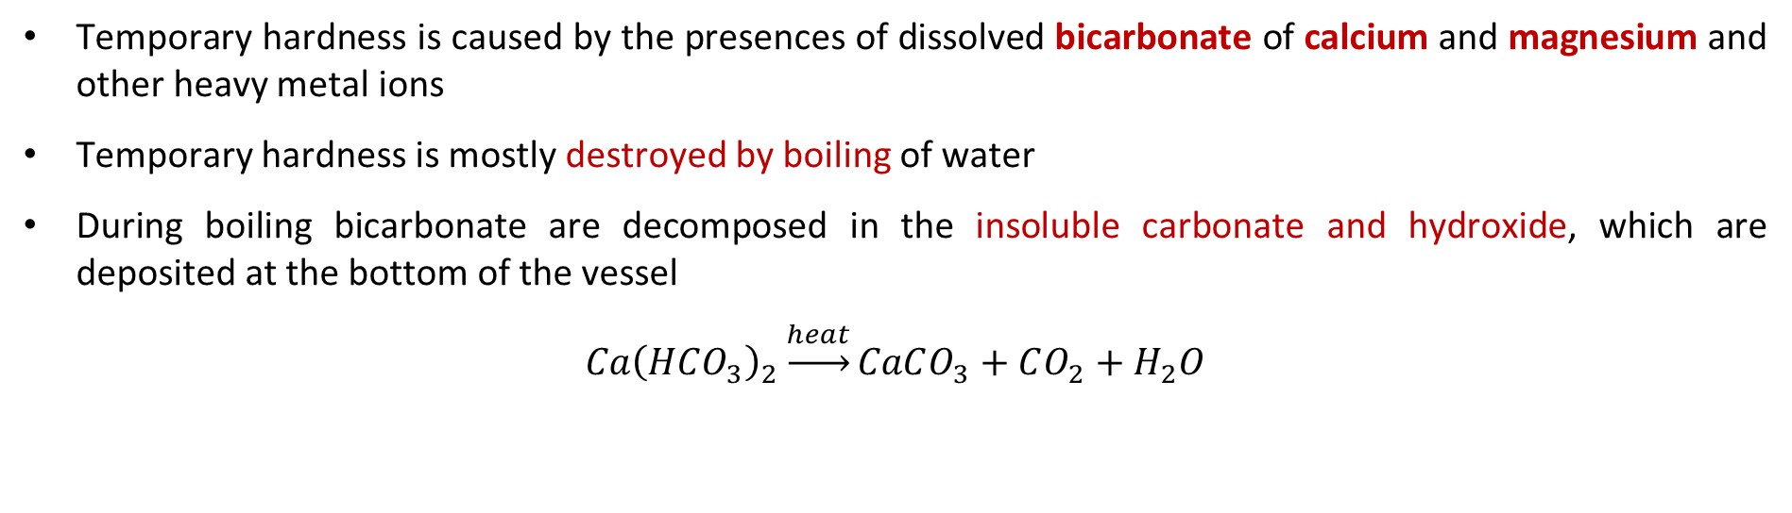
Hardness of water
Temporary hardness (Carbonate Hardness) and the Process of Removal
Temporary hardness is caused by the presences of dissolved bicarbonate of calcium and magnesium and other heavy metal ions
Temporary hardness is mostly destroyed by boiling of water
During boiling bicarbonate are decomposed in the insoluble carbonate and hydroxide, which are deposited at the bottom of the vessel
$$Ca{\left(HCO_{3}\right)}_{2}\underset{→}{heat}CaCO_{3}+CO_{2}+H_{2}O$$
Mg(HCO₃)₂ xMgCO₃∙ yMg(OH)₂∙zH₂O + aMgO + bH₂O + cCO₂
Here, x, y, z, and a, b, c vary as per the decomposition conditions
Permanent hardness (Non-carbonate Hardness)
This is due the presences of chlorides, nitrates, and sulphates of calcium, magnesium, iron and other heavy metal ions.

Slide 7
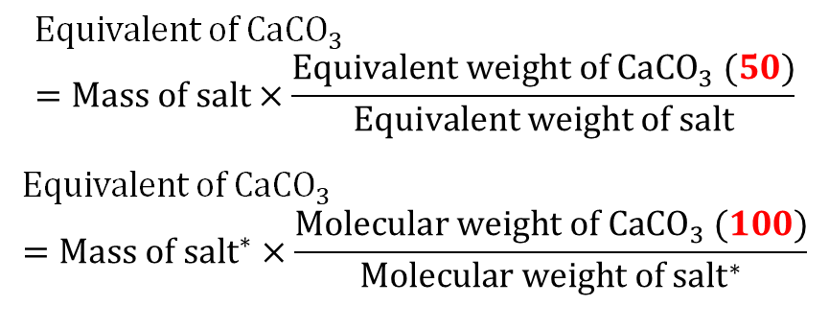
Measurement
Hardness is expressed in terms of equivalent of calcium carbonate because it is an insoluble salt that can be most easily precipitated in water treatment
Dissolved salt | Molar Mass | Chemical equivalent | Multiplication factor for converting into equivalent of CaCO₃
Ca(HCO₃)₂ | 162 | 81 | 100/162
Mg(HCO₃)₂ | 146 | 73 | 100/146
CaSO₄ | 136 | 68 | 100/136
CaCl₂ | 111 | 55.5 | 100/111
MgSO₄ | 120 | 60 | 100/120
MgCl₂ | 95 | 47.5 | 100/95
MgCO₃ | 84 | 42 | 100/84
$$Equivalent of {CaCO}_{3}=Mass of salt×\frac{Equivalent weight of {CaCO}_{3} (50)}{Equivalent weight of salt}$$
$$Equivalent of {CaCO}_{3}=Mass of {salt}^{∗}×\frac{Molecular weight of {CaCO}_{3} (100)}{Molecular weight of {salt}^{∗}}$$

Slide 8
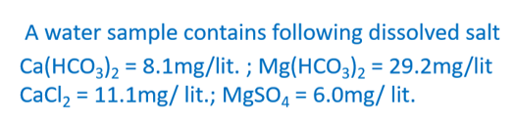
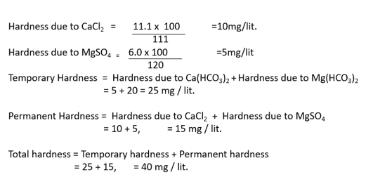
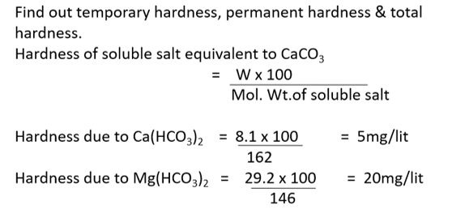
EXAMPLE

Slide 9

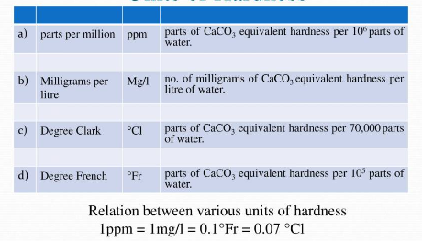
Units of Hardness
ppm
mg/L
Degree Clarke (°Cl)
Degree French (°Fr)

Slide 10
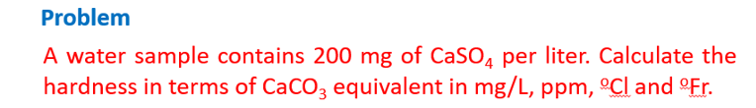
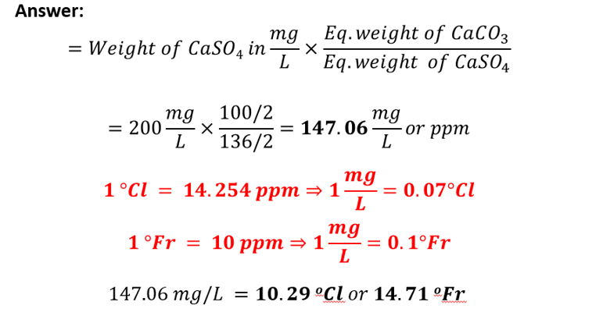

Slide 11
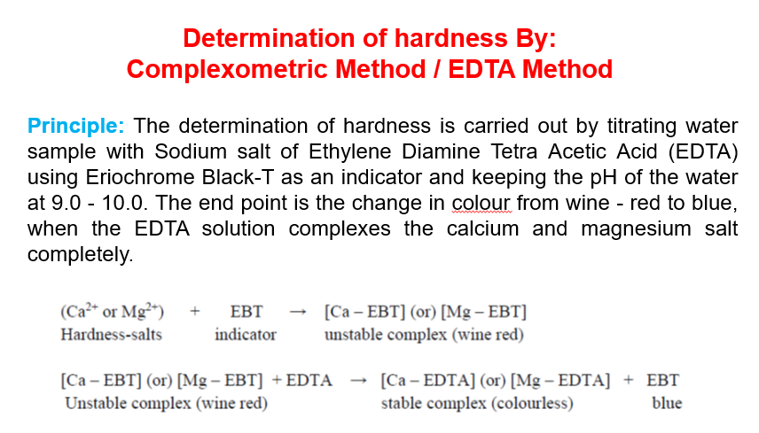

Slide 12
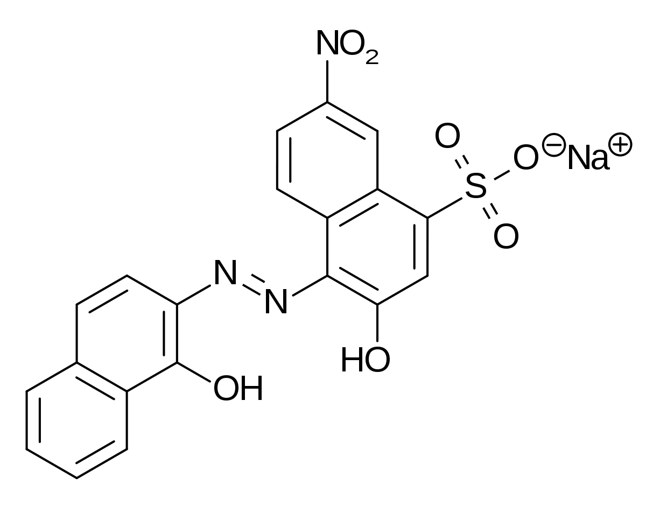
EDTA method
Hard water
+
EBT Indicator
+
10 pH buffer solution
Blue
Wine Red

Slide 13
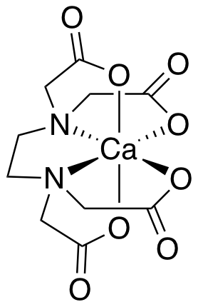
EDTA method
Blue
Wine Red

Slide 14
EDTA titration
EDTA:
EDTA is a weak acid – is not dissociated. It needs basic medium to release H⁺ ions and become charged
Hexadentate ligand – binds via 6 locations
N has lone pair, COO– has negative charge
Basic Buffer solution of pH = 10
Made with NH₄Cl + NH₄OH
Helps EDTA to lose H⁺ ions
Colour change
Initially wine-red because of metal-EBT complex (weak in nature)
After titration, blue because of free EBT indicator.
Metal-EDTA complex is colourless (strong complex).

Slide 15
Various steps involved in this method
Standardization of EDTA solution:
Rinse and fill the burette with EDTA solution. Pipette out V₁ ml of standard hard water (M₁) in a conical flask. Add 4-5 ml of buffer solution and 2 drops of EBT indicator. Titrate with EDTA solution till wine-red colour changes to clear blue. Let volume used by ‘V₂’ ml.
M₁.V₁ = M₂.V₂ » M₂ = (M₁.V₁)/V₂
Where, M₁ = Molarity of Standard Hard water,
V₁ = Volume of Standard Hard water,
M₂ = Molarity of EDTA,
V₂ = Volume of EDTA

Slide 16
2. Determination of Total Hardness:
Rinse and fill the burette with EDTA solution. Pipette out sample water (V₃) in a conical flask. Add 4-5 ml of buffer solution and 2 drops indicator. Titrate with EDTA solution till wine-red colour changes to clear blue. Let volume used by ‘V₄’ ml.
M₃.V₃ = M₄.V₄ » M₃ = (M₂.V₄)/V₃
Where, M₃ = Molarity of Sample Hard water,
V₃ = Volume of Sample Hard water,
M₄ = Molarity of EDTA = M₂,
V₄ = Volume of EDTA
Total Hardness = M₃ × Molecular weight of CaCO₃ (100) × One Litre (1000ml)
= M₃ × 10⁵ ppm

Slide 17
3. Determination of Permanent Hardness:
Take 100 ml of sample water in 250 ml beaker. Boil it to remove temporary hardness to about half of its volume and cool to room temperature, filter through filter paper to remove insoluble salts.
Make up the volume to the original 100ml by adding distilled water. Now Pipette out this solution (V₃ ml) in a conical flask. Add 4-5 ml of buffer solution and 2 drops indicator. Titrate with EDTA solution till wine-red colour changes to clear blue. Let volume used by ‘V₄’ ml.
M₃.V₃ = M₄.V₄ » M₃ = (M₂.V₄)/V₃
Where, M₃ = Molarity of Permanent Hard water,
V₃ = Volume of Permanent Hard water,
M₄ = Molarity of EDTA = M₂,
V₄ = Volume of EDTA
Permanent Hardness = M₃ × Molecular weight of CaCO₃ (100) × One Litre (1000ml)
= M₃ × 10⁵ ppm
4. Determination of Temporary Hardness:
Temporary Hardness = Total Hardness - Permanent Hardness

Slide 18
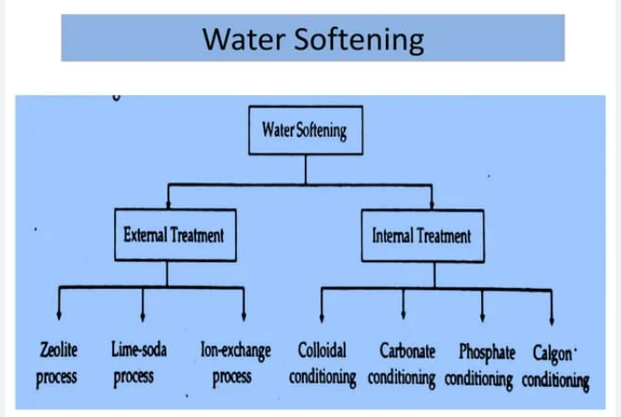
Softening of Hard Water

Slide 19
Water softening
Removal of hardness –
Hardness is …
Primarily Ca, Mg
and Fe, Mn, Al salts
Ions like Na⁺/K⁺/NH₄⁺ do NOT cause hardness
How do we remove hardness?
Ion exchange of Ca/Mg with ions H⁺/OH⁻ → Ion exchange resin process
Ion exchange of Ca/Mg with Na → Zeolite process
Precipitation of Ca and Mg → Soda-Lime process

Slide 20
Lime-Soda process
In this process, all the soluble hardness-causing impurities are converted
into insoluble precipitates which may be removed by setting and filtration.
In the lime soda process, calculated amount of lime Ca(OH)₂ and soda Na₂CO₃ is added in the hard water. The soluble calcium and magnesium salts in water are converted into insoluble compound such as calcium carbonate and magnesium hydroxide which may removed by setting and filtration.
(i) Lime removes the temporary hardness:
Ca(HCO₃)₂ + Ca(OH)₂ 2CaCO₃ + 2H₂O
Mg(HCO₃)₂ + 2Ca(OH)₂ Mg(OH)₂ + 2CaCO₃ + 2H₂O
(ii) Lime removes the permanent magnesium hardness:

Slide 21
(iii) Lime removes the dissolved iron and aluminum salts:
(iv) Lime removes free mineral acids:
(v) Lime removes dissolved CO₂ and H₂S:
(vi) Soda removes all calcium permanent hardness:

Slide 22
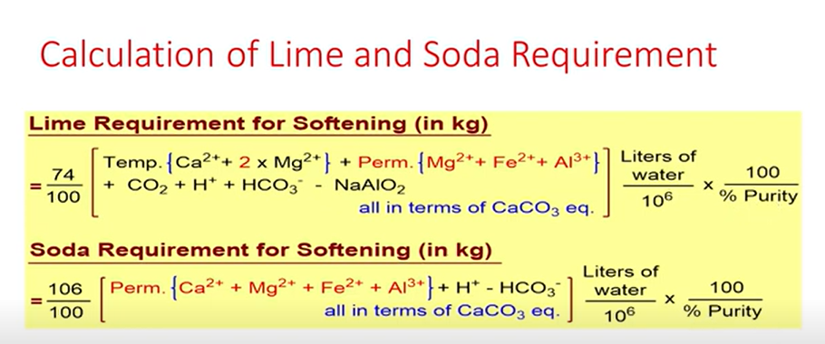

Slide 23
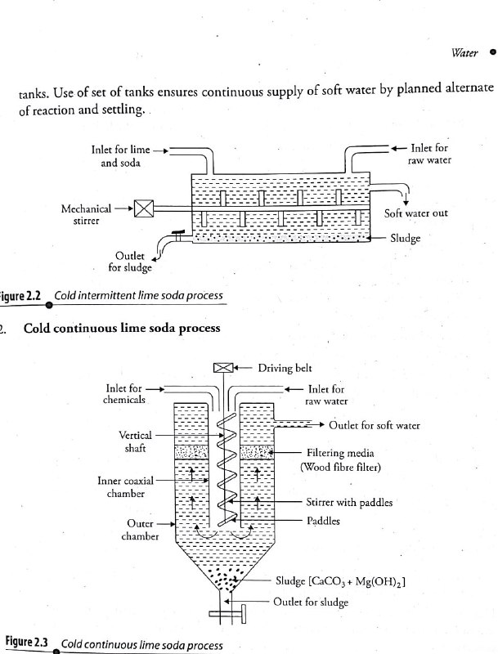
Lime-Soda process
Intermittent Cold Lime Soda Softener
In this process –
Calculated quantity of lime and soda are mixed with water at room temperature
The precipitates formed are finely divided, so they do not settle down easily.
Therefore, small amounts of coagulants (like alum, aluminum sulphate, sodium aluminates etc.).
Use of sodium aluminate as coagulant also helps the removal of silica as well as oil if present in water..
NaAlO₂ + 2 H₂O → NaOH + Al(OH)₃
Al₂(SO₄)₃ + 3 Ca(HCO₃)₂ → 2 Al(OH)₃ + 3 CaSO₄ + 6 CO₂

Slide 24
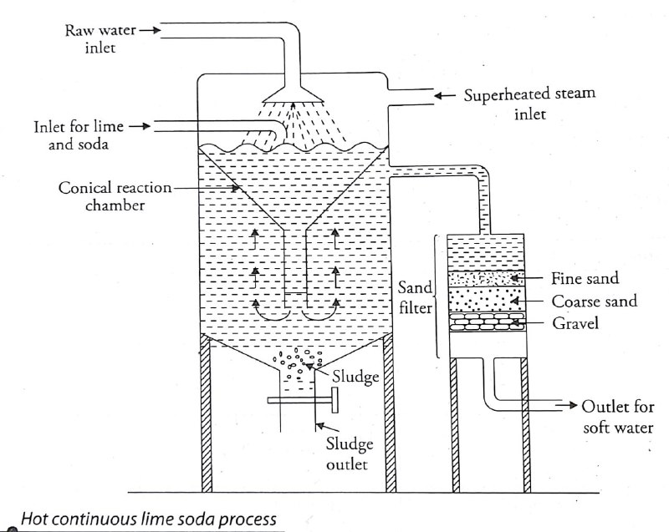
Lime-Soda process
Continuous Cold Lime Soda Softener
Continuous Hot Lime Soda Process

Slide 25
Lime-Soda process
Hot lime soda process
Calculated quantity of lime and soda are mixed with water at 80°C.
Advantages:
The reaction proceeds faster.
Softening capacity is increased.
No coagulant needed as the precipitate and sludge formed settle down rapidly.
Much of the dissolved gases are driven out of water.
Viscosity of soften water is lower, so filtration of water becomes easier.
This process produces water of comparatively low residual hardness 15 to 30 ppm.

Slide 26
Lime-Soda process
Advantages of lime soda process
It is very economical.
If the process is combined with sedimentation/coagulation lesser amounts of coagulants shall be needed.
The process increases the pH of the treated water.
In addition to the removal of hardness, the quantities of minerals in the water are reduced.
Due to alkaline nature of treated water, number of pathogenic bacteria in water is considerably reduced.
Disadvantages of lime soda process
For efficient and economical softening, careful operation and skilled supervision is required.
Disposal of large amount of sludge poses a problem.
This can remove hardness up to 15 ppm which is not good for boilers.
Cannot be used in high pressure boilers as appreciable number of soluble salts (Na₂SO₄) might be present.
Cannot be used for household purposes as the calculation for required amount of lime and soda is hard.

Slide 27
Water softening: Ion Exchange Method
Ion exchange or deionization or demineralization process:
Ion-exchange resins are widely used in different separation, purification, and decontamination processes.
Ion-exchange resins are –
insoluble,
cross linked,
long chain organic polymer,
with micro porous structure and,
the functional groups attached to the chains are responsible for the ion exchange properties.

Slide 28
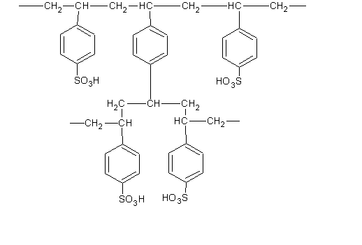
Cation exchange resins
Resins containing acidic functional groups (-COOH, -SO₃H, phenolic -OH) are capable of exchanging their H⁺ ions with other cations which comes in their contacts, known as a cation exchange resins (RH⁺).
e.g. styrene divinyl benzene (Amberlite IR-120 or Dowex-50), which on sulphonation and carboxylation, become capable to exchange their hydrogen ions with the cations (Metal ions) in the water.

Slide 29
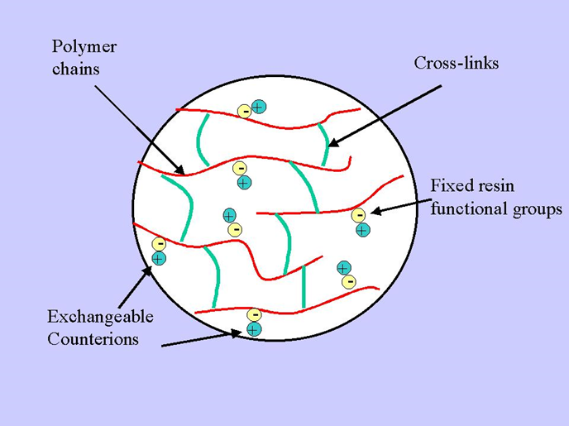
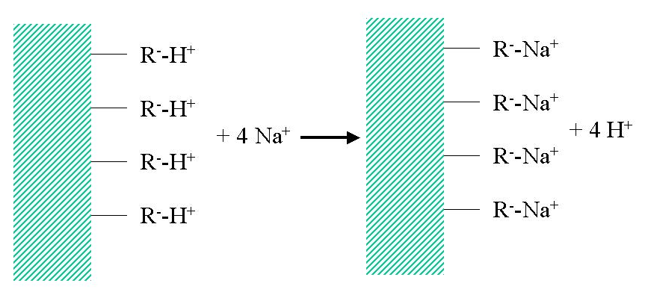
Water softening
Ion exchange or deionization or demineralization process:
Ion-exchange resins are widely used in different separation, purification, and decontamination processes.

Slide 30
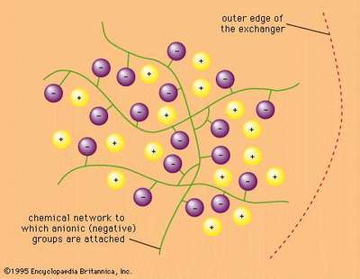
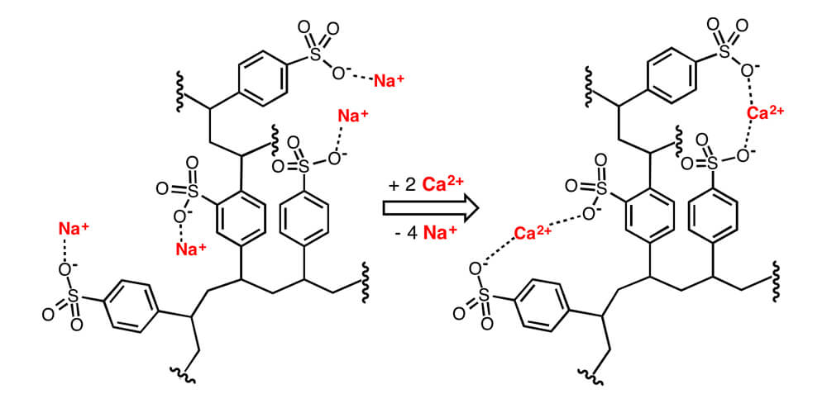
Water softening
Ion exchange or deionization or demineralization process:
Ion-exchange resins are widely used in different separation, purification, and decontamination processes.

Slide 31
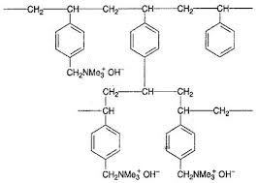
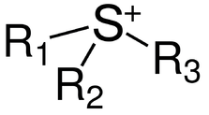
Anion exchange resins (R⁺OH⁻)
Resins containing basic functional groups (-NR₃⁺OH⁻) are capable of exchanging their anions with other anions which comes in their contacts, known as a Anion exchange resins (ROH⁻).
-PR₃⁺
Quaternary
Phosphonium group
Quaternary
Sulphonium
group
Quaternary
Ammonium
group

Slide 32
Anion exchange resins (R⁺OH⁻)
Resins containing basic functional groups (-NR₃⁺OH⁻) are capable of exchanging their anions with other anions which comes in their contacts, known as a Anion exchange resins (ROH⁻).
They are styrene divinyl benzene or amine-formaldehyde copolymerization which contains
quaternary ammonium or
quaternary phosphonium or
tertiary sulphonium groups
as an integral part of the resin matrix.
These after treated with dil. NaOH becomes capable of exchanging their OH- ions with anions of water sample.

Slide 33
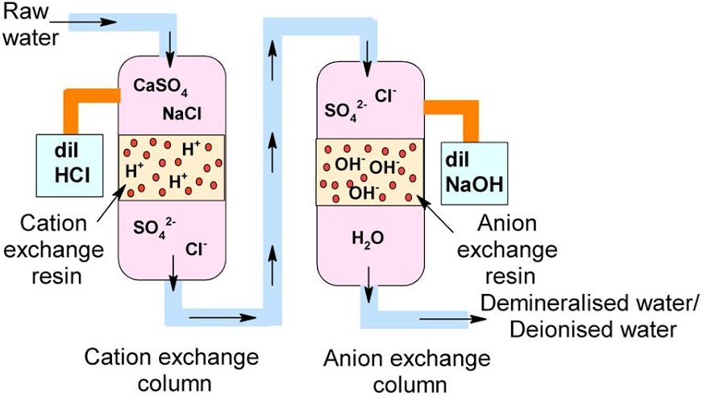
Ion exchange resins
Step 1: Cation exchange
2RH⁺ + Ca²⁺ → R₂Ca²⁺ + 2H⁺
2RH⁺ + Mg²⁺ → R₂Mg²⁺ + 2H⁺
Step 2: Anion exchange
ROH- + Cl- → RCl- + OH-
2ROH- + SO₄²⁻ → R₂SO₄²⁻ + 2OH-
Water coming out from the exchange is free from cations and anions.
H ⁺ + OH- → H₂O
Ion free water is known as deionized or demineralized water.
The process
Regeneration:
R₂Ca²⁺ + 2 HCl → 2RH⁺ + CaCl₂
R₂Mg²⁺ + H₂SO₄ → 2RH⁺ + MgSO₄
R₂SO₄²⁻ + 2 NaOH → 2ROH- + Na₂SO₄
RCl⁻ + KOH → ROH- + KCl

Slide 34
Pros and Cons
Advantages:
Can be used to soften highly acidic or alkaline waters.
It produces water of very low hardness.
Disadvantages:
The equipment is costly
Expensive chemicals are needed
Output of the process is reduced if water contains turbidity. (turbidity must be below 10 ppm)

Slide 35
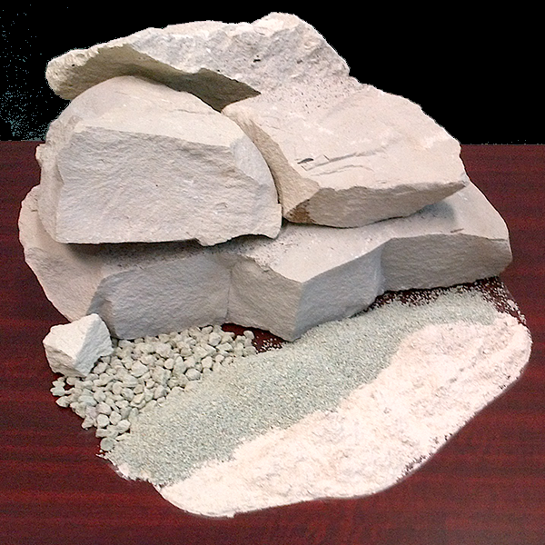
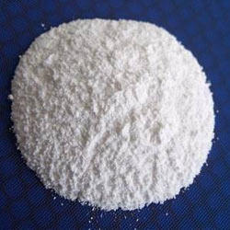
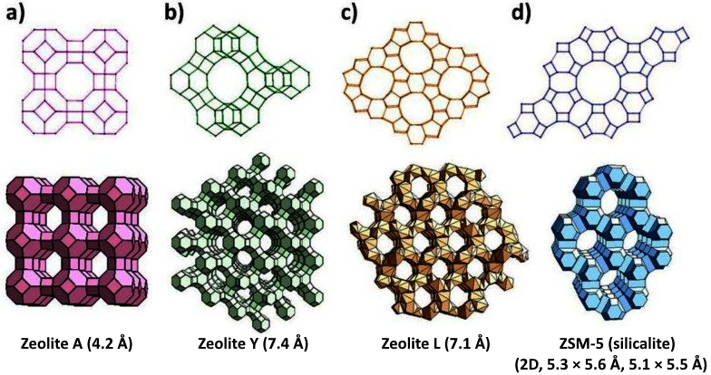
Zeolite (Permutit) method of Softening of water
Zeolite is a Hydrated Sodium Alumino Silicate (HSAS), capable of exchanging reversibly its sodium ions for hardness producing ions in water.
The general chemical structure of zeolite is –
Na₂O·Al₂O₃·xSiO₂·yH₂O
(x = 2-10 and y = 2-6)
Porosity or cavity size of synthetic zeolite structures can be controlled by varying the Si/Al ratio
Ion-exchange process of zeolite structure is associated with sodium ions

Slide 36
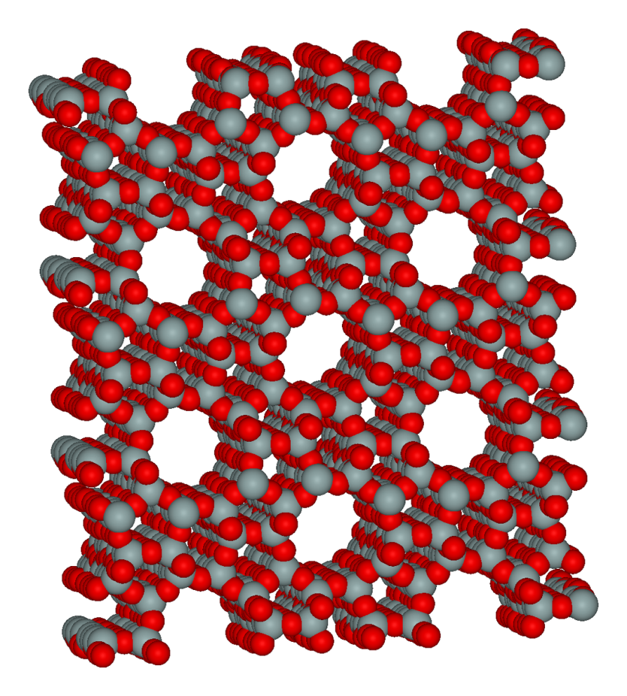
Process of softening by Zeolite method
For the purification of water by the zeolite softener, hard water is passed through the zeolite bed at a specified rate.
The hardness causing ions such as Ca²⁺, Mg²⁺ are retained by the zeolite bed as CaZe and MgZe respectively.
The outgoing water contains sodium salts.
Micro pores of Zeolite
Porous Structure of zeolite

Slide 37
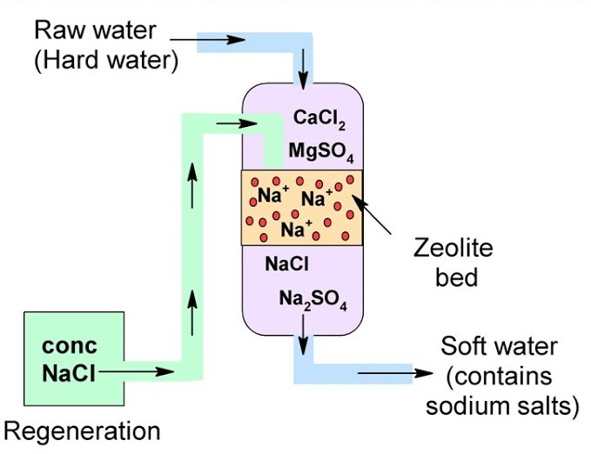
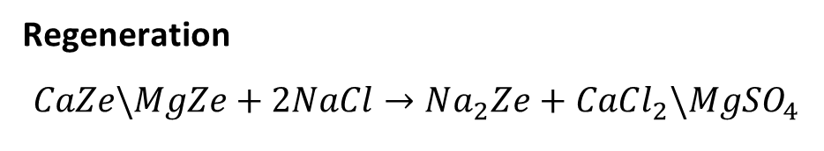
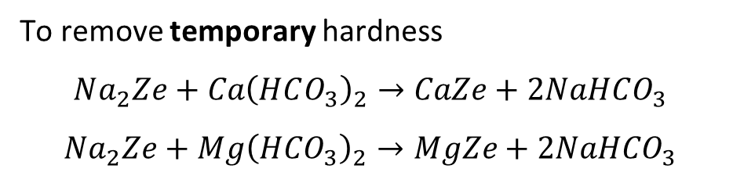
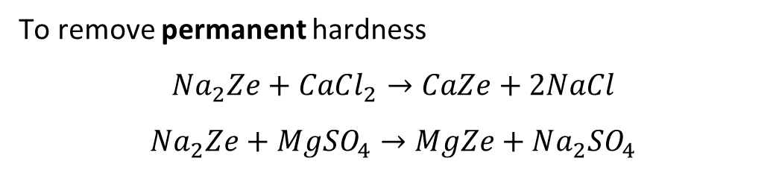
Zeolite softener
Process of softening by Zeolite method
To remove permanent hardness
$$Na_{2}Ze+CaCl_{2}→CaZe+2NaCl$$
$$Na_{2}Ze+MgSO_{4}→MgZe+Na_{2}SO_{4}$$
To remove temporary hardness
$$Na_{2}Ze+Ca{\left(HCO_{3}\right)}_{2}→CaZe+2NaHCO_{3}$$
$$Na_{2}Ze+Mg{\left(HCO_{3}\right)}_{2}→MgZe+2NaHCO_{3}$$
Regeneration
$$CaZe\backslash MgZe+2NaCl→Na_{2}Ze+CaCl_{2}\backslash MgSO_{4}$$

Slide 38
Limitations of Zeolite process
If the water is turbid: then the turbidity causing particles clogs the pores of the Zeolite and making it inactive
The ions such as Mn²⁺ and Fe²⁺ forms stable complex Zeolite which cannot be regenerated that easily as both metal ions bind strongly and irreversibly to the zeolite structure.
Any acid present in water (acidic water) should be neutralized with soda before admitting the water to the plant.
Na₂O·Al₂O₃·xSiO₂·yH₂O
(Zeolite)

Slide 39
Advantages of Zeolite process
Soft water of 10-15 ppm can be produced by this method.
The equipment occupies less space.
No impurities are precipitated, hence no danger of sludge formation in the treated water.
It does not require more time and more skill.
Disadvantages of Zeolite process
Soft water contains more sodium salts than in lime soda process.
It replaces only Ca²⁺ and Mg²⁺ with Na⁺ but leaves all the other ions like HCO₃⁻ and CO₃²⁻ in the softened water (then it may form NaHCO₃ and Na₂CO₃ which releases CO₂ when the water is boiled and causes corrosion).
It also causes caustic embrittlement when Na₂CO₃ hydrolyses to give NaOH.

Slide 40
Internal Treatment of Hard Water

Slide 41
Internal treatment
In this process, an ion is prohibited to exhibit its original character by complexing or converted into other more soluble salt by adding appropriate reagent.
An internal treatment is accomplished by adding a proper chemical to water either:
To precipitate the scale forming impurities in the form of sludge, which can be removed.
To convert them into compounds, which will stay dissolved in water and thus do not cause any harm.
Important Internal Treatments are –
Colloidal treatment
Phosphate conditioning
Calgon conditioning

Slide 42
Internal treatment
a) Colloidal treatment
This treatment involves addition of conditioning agents such as glue, seaweed extract, agar-agar, tannin to the boiler water.
The residual precipitates get surrounded by molecules of the conditioning agents and effectively maintains non-sticky colloidal state.
Once colloidal solution become concentrated, the colloids may be easily removed by blow-down operation.

Slide 43
Internal treatment
b) Phosphate conditioning
Scale formation can be avoided by adding sodium phosphate which reacts with hardness of water forming non-adherent and easily removable soft sludge of calcium and magnesium phosphate.
3CaCl₂ + 2Na₃PO₄ → Ca₃(PO₄)₂ + 6NaCl
The choice of salt depends upon the alkalinity of the boiled water because calcium cannot be precipitated below a pH 9.5.
Trisodium phosphate (Na₃PO₄) is most suitable for treatment when alkalinity is low
Disodium phosphate (Na₂HPO₄) is used when the water alkalinity is sufficient.
Monosodium phosphate (NaH₂PO₄) is used when the alkalinity of boiler water is too high.

Slide 44
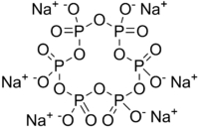
Internal treatment
c) Calgon conditioning:
It involves adding calgon - Sodium hexa-meta phosphate (NaPO₃)₆ to boiler water. It prevents the scale and sludge formation by forming soluble complex compound with CaSO₄.
[Na₆(PO₃)₆] → 2 Na⁺ + [Na₄P₆O₁₈]²⁻
2 CaSO₄ + [Na₄P₆O₁₈]²⁻ → [Ca₂P₆O₁₈]²⁺ + 2 Na₂SO₄
soluble complex ion

Slide 45
END OF LECTURE

Slide 46
Practice
Numericals Related to Hard Water

Slide 47
Problem:
50 ml of standard hard water containing 1 gram of pure CaCO3 per liter consumed 20 ml of EDTA. 50 ml of hard water consumed 25 ml of same EDTA solution and EBT indicator. Calculate the total hardness of water sample in ppm.

Slide 49
Problem:
0.28 grams of CaCO3 were dissolved in HCl and the solution was made up to one litre with distilled water. 100 ml of the above solution required 28 ml of EDTA solution on titration. 100 ml of hard water sample consumed 33 ml of same EDTA solution EBT indicator. 100 ml of this water after boiling cooling and filtering required 10 ml of EDTA solution in titration. Calculate the permanent and temporary hardness of water sample in ppm.

Slide 51
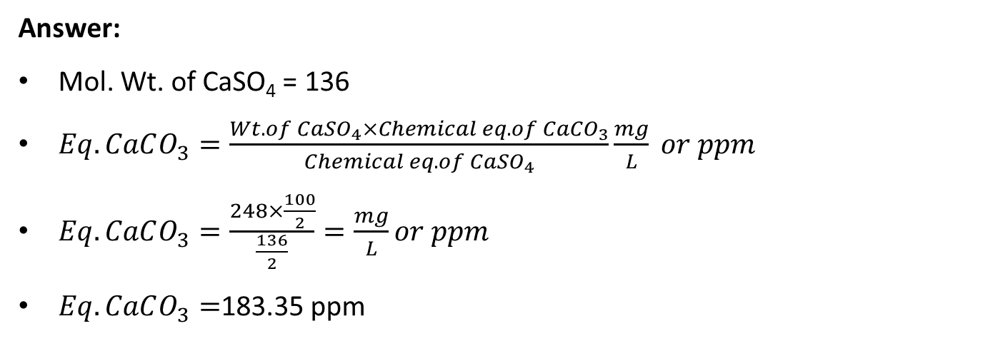
A water sample contains 248 mg CaSO₄ per litre. Calculate the hardness of the water in CaCO₃ equivalent.
Answer:
Mol. Wt. of CaSO₄ = 136
$Eq. CaCO_{3}=\frac{Wt. of CaSO_{4}×Chemical eq. of CaCO_{3}}{Chemical eq. of CaSO_{4}}\frac{mg}{L} or ppm$
$Eq. CaCO_{3}=\frac{248×\frac{100}{2}}{\frac{136}{2}}=\frac{mg}{L}or ppm$
$Eq. CaCO_{3}=$183.35 ppm

Slide 52
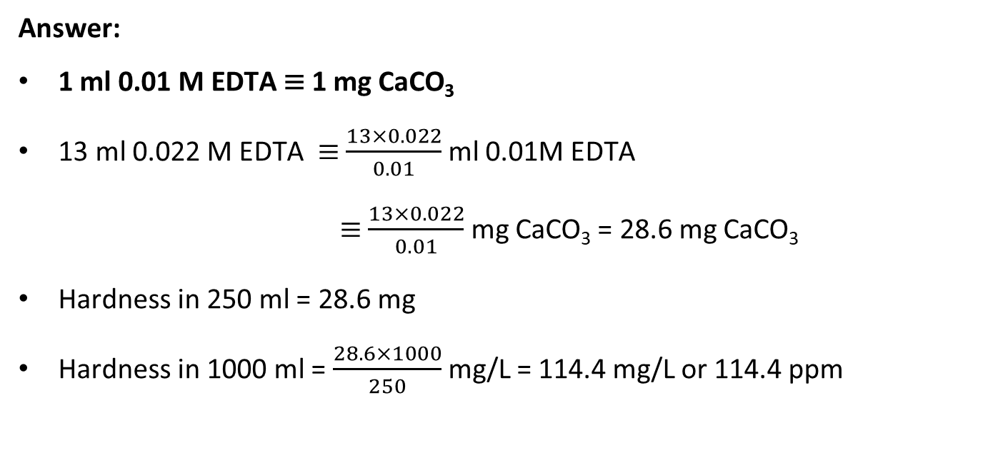
Problems
250 ml water sample upon EDTA titration with EBT consumed 13 ml of 0.022 M EDTA till the end point was reached. Calculate the hardness of the water sample.
Answer:
1 ml 0.01 M EDTA ≡ 1 mg CaCO₃
13 ml 0.022 M EDTA ≡ $\frac{13×0.022}{0.01}$ ml 0.01M EDTA
≡ $\frac{13×0.022}{0.01}$ mg CaCO₃ = 28.6 mg CaCO₃
Hardness in 250 ml = 28.6 mg
Hardness in 1000 ml = $\frac{28.6×1000}{250}$ mg/L = 114.4 mg/L or 114.4 ppm

Slide 53
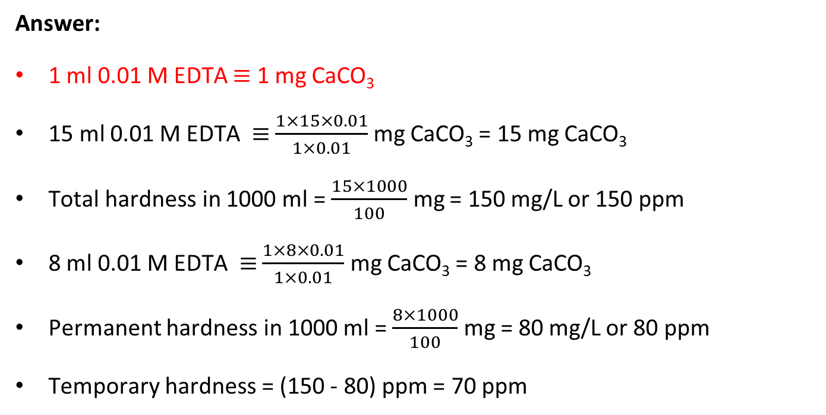
Problems
100 ml water sample upon EDTA titration with EBT consumed 15 ml of 0.01 M EDTA till the end point was reached. Another part of the sample was boiled to remove temporary hardness. This solution required 8 ml 0.01 M EDTA to reach the end point. Calculate the temporary and permanent hardness of the water sample.
Answer:
1 ml 0.01 M EDTA ≡ 1 mg CaCO₃
15 ml 0.01 M EDTA ≡ $\frac{1×15×0.01}{1×0.01}$ mg CaCO₃ = 15 mg CaCO₃
Total hardness in 1000 ml = $\frac{15×1000}{100}$ mg = 150 mg/L or 150 ppm
8 ml 0.01 M EDTA ≡ $\frac{1×8×0.01}{1×0.01}$ mg CaCO₃ = 8 mg CaCO₃
Permanent hardness in 1000 ml = $\frac{8×1000}{100}$ mg = 80 mg/L or 80 ppm
Temporary hardness = (150 - 80) ppm = 70 ppm

Slide 54
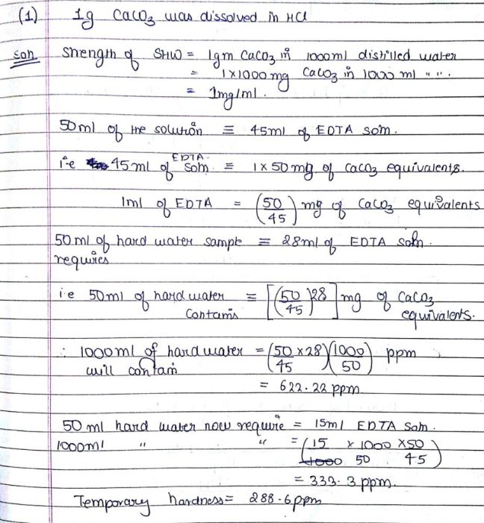
Practice Problems
1.0 gm of CaCO₃ was dissolved in HCl and the solution made up to 1000 ml with distilled water. 50 ml of the solution required 45 ml of EDTA solution for titration. 50 ml of hard water sample required 28 ml of EDTA and after boiling and filtering required 15 ml of EDTA solution. Calculate the hardness of water.
ANS: Total hardness: 621.6 ppm, Permanent hardness: 333 ppm, Temp. hardness: 288.6 ppm

Slide 55
Problems
0.28 g of CaCO₃ was dissolved in HCl and the solution was made to 1 lit with distilled water. 100 ml of this sample upon EDTA titration with EBT consumed 28 ml of EDTA till the end point was reached.
100 ml of a hard water sample required 35 ml of the same EDTA solution on titration. After boiling, filtering, and titrating 100 ml of this water required 10 ml EDTA solution. Calculate the hardness of the water sample.
Answer:
1 ml 0.01 M EDTA ≡ 1 mg CaCO₃
0.28 g = 280 mg in 1 lit water ≡ 280 ppm or 280 mg/L
100 ml of this solution (28 mg CaCO₃) consumes 28 ml of EDTA i.e., EDTA is of strength 0.01 M
Total: 35 ml 0.01 M EDTA for 100 ml → 350 ppm
Permanent: 10 ml 0.01 M EDTA for 100 ml → 100 ppm
Temporary = (350-100) ppm = 250 ppm

Slide 56
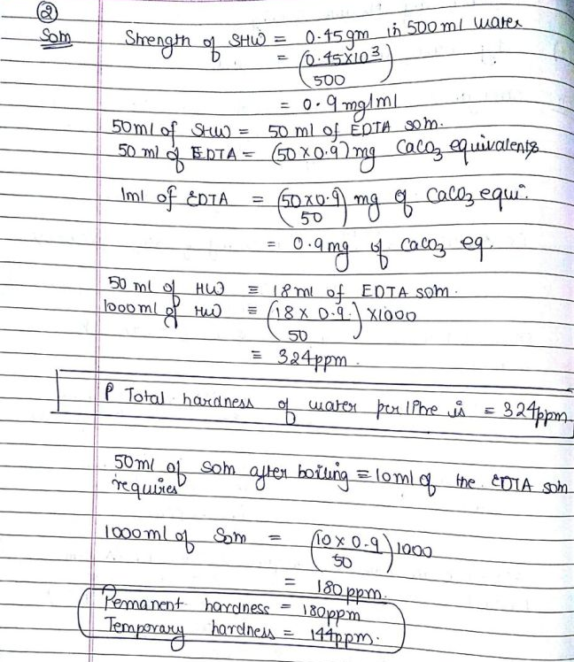
Practice Problems
0.45 gm of CaCO₃ was dissolved in HCI and the solution made up to 500 ml with distilled water. 50 ml of the solution required 50 ml of EDTA solution for titration. 50 ml of hard water sample required 18 ml of EDTA and after boiling and filtering required 10 ml of EDTA solution. Calculate each type of hardness of water.
ANS: Total hardness: 324 ppm, Permanent hardness: 180 ppm, Temp. hardness: 144 ppm

Slide 57
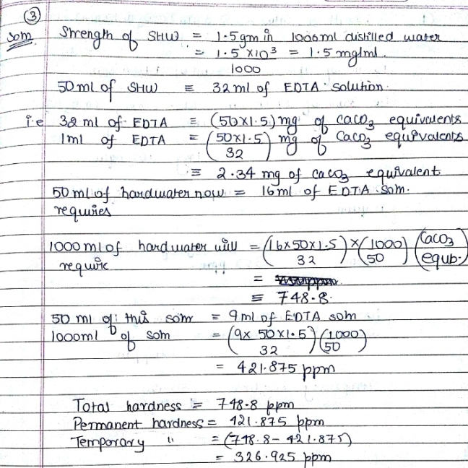
Practice Problems
1.53m of CaCO₃ was dissolved in HCI and the solution made up to 1000 ml with distilled water. 50 ml of the solution required 32 ml of EDTA solution for titration. 50 ml of hard water sample required 16 ml of EDTA and after boiling and filtering required 9 ml of EDTA solution. Calculate temporary, permanent and total hardness of water.
ANS: Total hardness: 748.8 ppm, Permanent hardness: 270 ppm, Temp. hardness: 478.8 ppm

Slide 58
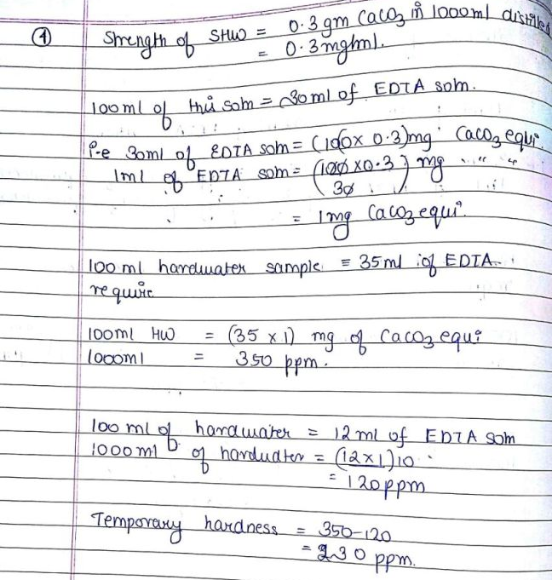
Problems
0.30 gm of CaCO₃ was dissolved in HCl and the solution made up to 1000 ml with distilled water. 100 ml of the solution required 30 ml of EDTA solution for titration. 100 ml of hard water sample required 35 ml of EDTA and after boiling and filtering required 12 ml of EDTA solution. Calculate temporary hardness of water.
ANS: Total hardness: 350 ppm, Permanent hardness: 120 ppm, Temp. hardness: 230ppm

Slide 59
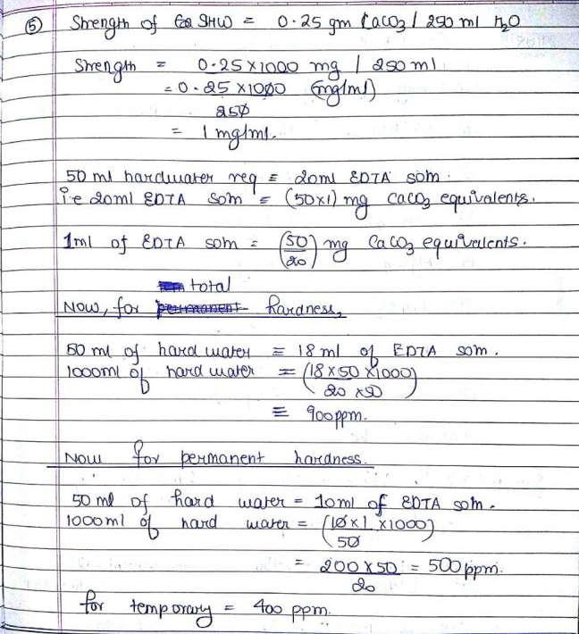
Problems
0.25 gm of CaCO₃ was dissolved in HCI and the solution made up to 250 ml with distilled water. 50 ml of the solution required 20 ml of EDTA solution for titration. 50 ml of hard water sample required 18 ml of EDTA and after boiling and filtering required 10 ml of EDTA solution. Calculate temporary hardness of water.
ANS: Total hardness: 900 ppm, Permanent hardness: 500 ppm, Temp. hardness: 400ppm

Slide 60
Problems
25 ml of standard hard water consumes 12 ml of standard EDTA solution. 25 ml of hard water sample consumes 8 ml of EDTA solution. After boiling the sample, 25 ml of this sample consumed 6 ml of standard EDTA solution. Calculate the hardness of the water sample. Standard hard water = 1000 ppm
ANS: Total hardness: 666.67 ppm,
Permanent hardness: 500 ppm,
Temp. hardness = 166.67 ppm

Slide 61
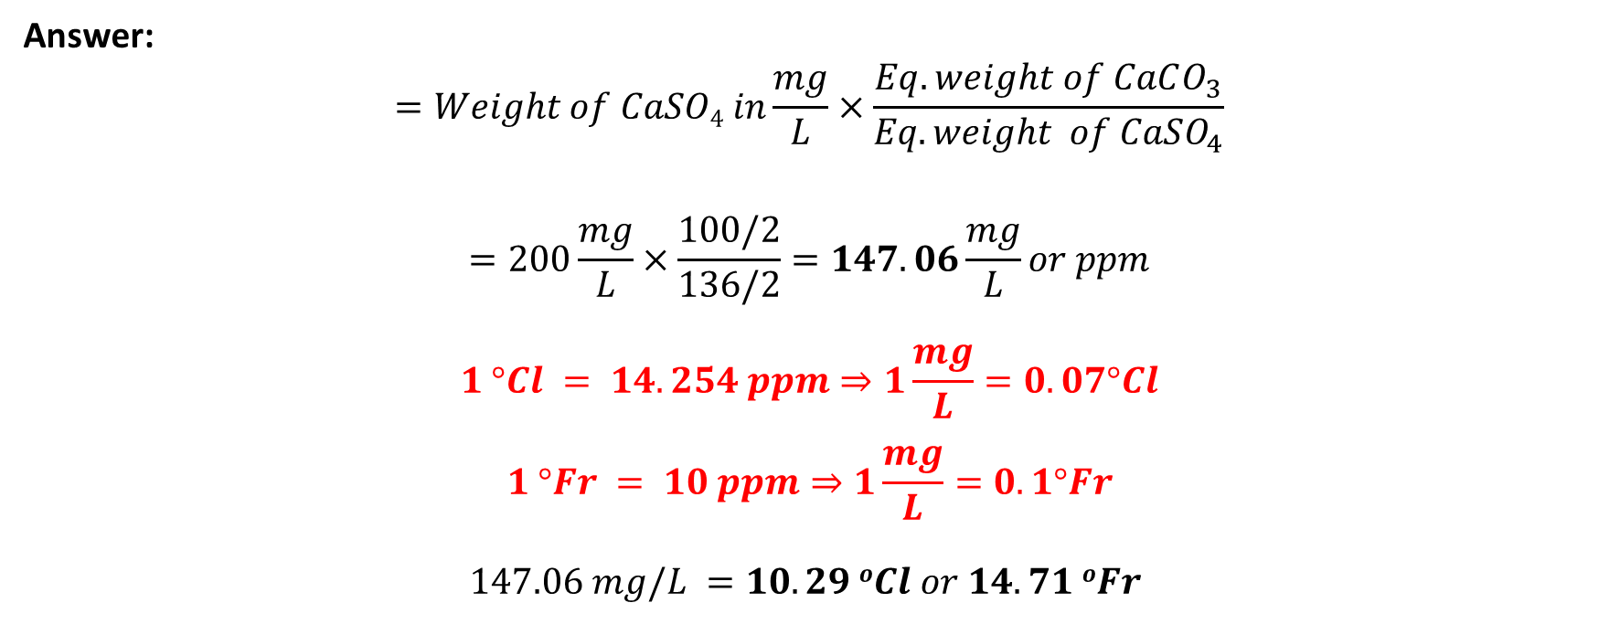
A water sample contains 200 mg of CaSO₄ per liter. Calculate the hardness in terms of CaCO₃ equivalent in mg/L, ppm, ºCl and ºFr.
Answer:
$$=Weight of CaSO4 in\frac{mg}{L}×\frac{Eq. weight of CaCO_{3}}{Eq. weight of CaSO_{4}}$$
$$=200\frac{mg}{L}×\frac{100/2}{136/2}=147.06\frac{mg}{L}or ppm$$
$$1 °Cl = 14.254 ppm⇒1\frac{mg}{L}=0.07°Cl$$
$$1 °Fr = 10 ppm⇒1\frac{mg}{L}=0.1°Fr$$
$$147.06 mg/L =10.29 oCl or 14.71 oFr$$

Slide 62

How many grams of MgCl₂ dissolved in 1 liter water will cause hardness of 76 ppm?
Answer:
Molecular weight of MgCl₂ = 95
Let $x\frac{mg}{L}$ MgCl₂ dissolved in water gives 76 ppm hardness.
$x×\frac{M.W._{CaCO_{3}}}{M.W._{MgCl_{2}}}=76$
$x×\frac{100}{95}=76$
$x=72.2\frac{mg}{L}=0.072g$

Slide 63
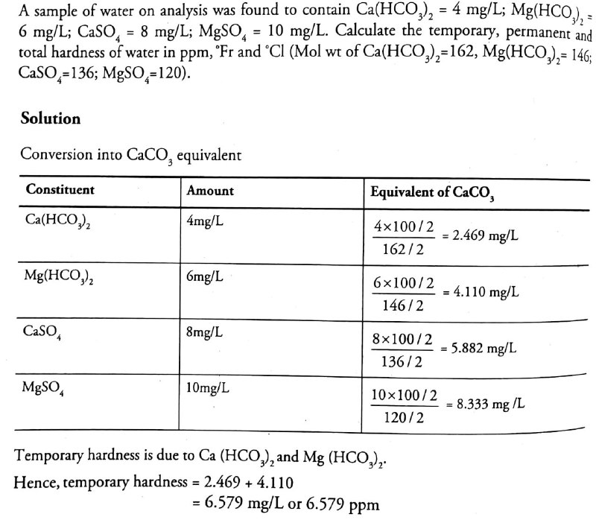

Slide 64
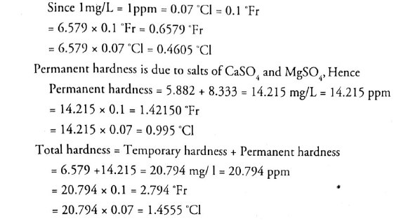

Slide 65
The samples A, B, and C were analyzed for their salt's contents:
Sample A was found to contain 155 mg of magnesium carbonate per litre.
Sample B was found to contain 800 mg of calcium nitrate, 5.1 mg of sodium chloride, and 2.5 mg of silica per litre.
Sample C contains 15 mg of potassium nitrate, and 3 g of calcium carbonate per litre.
Determine the hardness in all above three samples in ppm.
Molecular weights: MgCO₃=84; Ca(NO₃)₂=164, NaCl=58.5, silica/SiO₂=60, CaCO₃=100
Answer:
A = 184.52 ppm, B = 487.52 ppm, C = 3000 ppm

Slide 66
The samples A and B were analyzed for their salts contents:
Sample A was found to contain 168 mg of magnesium carbonate per 500 mL. Sample B was found to contain 820 mg of calcium nitrate per 250 mL
Determine the hardness in all above two samples in ppm.
Molecular weights: MgCO₃=84; Ca(NO₃)₂=164

Slide 67
Calculate the temporary hardness and permanent hardness of a sample of water containing: Mg(HCO₃)₂ = 7.3 mg/L; Ca(HCO₃)₂ = 16.2 mg/L; MgCl₂ = 9.5 mg/L; CaSO₄ = 13.6 mg/L
Molecular weights: Ca(HCO₃)₂ = 162; Mg(HCO₃)₂=146; CaSO₄= 136; MgSO₄ = 120; MgCl₂ = 95; Al₂(SO₄)₃ = 114; Ca(NO₃)₂=164

Slide 68
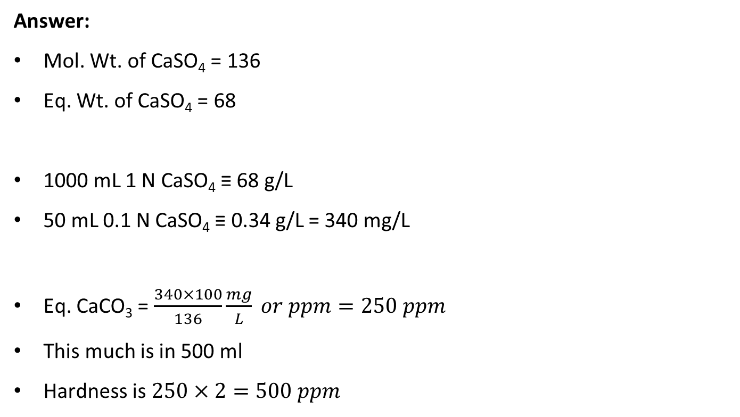
A water sample (500 mL) has hardness equivalent for 50 mL of 0.1 N CaSO₄. What is the hardness in ppm?
Answer:
Mol. Wt. of CaSO₄ = 136
Eq. Wt. of CaSO₄ = 68
1000 mL 1 N CaSO₄ ≡ 68 g/L
50 mL 0.1 N CaSO₄ ≡ 0.34 g/L = 340 mg/L
Eq. CaCO₃ = $\frac{340×100}{136}\frac{mg}{L} or ppm=250 ppm$
This much is in 500 ml
Hardness is $250×2=500 ppm$

Slide 69
Q. Calculate the amount of lime required for softening 50,000 litre of hard water containing MgSO₄ = 144 ppm, CaCl₂ = 111 ppm, MgCl₂ = 95 ppm; Na₂SO₄ = 15 ppm, SiO₂ = 25 ppm.
MW: Ca(HCO₃)₂ = 162; Mg(HCO₃)₂=146; CaSO₄= 136; MgSO₄ = 120; ; MgCl₂ = 95
Answer:
Lime required = 74/100 [(MgSO₄) + (MgCl₂)] × Volume of water = ???
Soda required = 106/100 [(MgSO₄) + (CaCl₂) + (MgCl₂)] × Volume of water = ???
Constituent | Amount (ppm) | CaCO₃ equivalent (ppm) | Lime/soda requirement
MgSO₄ | 144 | 144 × 100/120 = 120 | L+S
CaCl₂ | 111 | 111 × 100/111 = 100 | S
MgCl₂ | 95 | 95 × 100/95 = 100 | L+S
Na₂SO₄ | NA | NA | ×
Fe₂O₃ | NA | NA | ×

Slide 70
Problem
Q. Calculate the quantity of lime and soda required for softening 50000 litres of water containing the following salts per litre:
Ca(HCO₃)₂ = 8.1 mg (MW=162); Mg(HCO₃)₂ = 7.5 mg (MW=146); CaSO₄ = 13.6 mg (MW=136); MgSO₄ = 12.0 mg (MW=120), MgCl₂ = 2.0 mg (MW=95), NaCl = 4.7 mg (MW=58.5).
Calculate the quantities of lime and soda required if purity is 90% for both lime and soda.
Answer:
Constituent | Amount (mg/lit) | CaCO₃ equivalent | Lime/soda requirement
Ca(HCO₃)₂ | 8.1 | 100/162 × 8.1 = 5.0 | L
Mg(HCO₃)₂ | 7.5 | 100/146 × 7.5 = 5.14 | 2L
CaSO₄ | 13.6 | 100/136 × 13.6 = 10.0 | S
MgSO₄ | 12.0 | 100/120 × 12 = 10.0 | L+S
MgCl₂ | 2.0 | 100/95 2 = 2.11 | L+S
NaCl | 4.7 | N.A. | ×

Slide 71
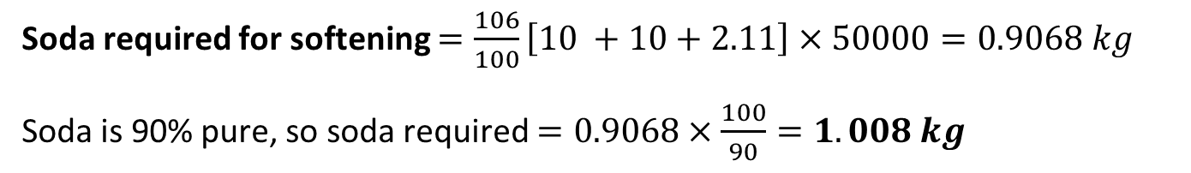
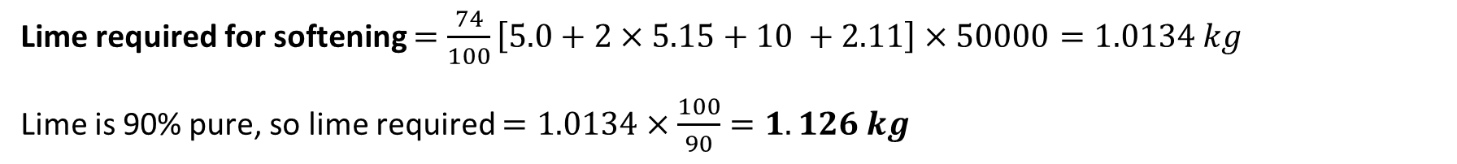
Problem
Q. Calculate the quantity of lime and soda required for softening 50000 litres of water containing the following salts per litre:
Ca(HCO₃)₂ = 8.1 mg; Mg(HCO₃)₂ = 7.5 mg; CaSO₄ = 13.6 mg; MgSO₄ = 12.0 mg, MgCl₂ = 2.0 mg, NaCl = 4.7 mg.
Calculate the quantities of lime and soda required if purity is 90% for both lime and soda.
Answer:
Lime required for softening $=\frac{74}{100}\left[5.0+2×5.15+10 +2.11\right]×50000=1.0134 kg$
Lime is 90% pure, so lime required $=1.0134×\frac{100}{90}=1.126 kg$
Soda required for softening $=\frac{106}{100}\left[10 +10+2.11\right]×50000=0.9068 kg$
Soda is 90% pure, so soda required $=0.9068×\frac{100}{90}=1.008 kg$

Slide 72
Problem
Q. Calculate the amount of lime (84% pure) and soda (92% pure) required for softening 20,000 litre of hard water containing Ca(HCO₃)₂ = 40.5 ppm; Mg(HCO₃)₂ = 36.5 mg; CaSO₄ = 34 mg; MgSO₄ = 30 mg; CaCl₂ = 27.75 mg; NaCl = 4.7 mg.
MW: Ca(HCO₃)₂ = 162; Mg(HCO₃)₂ = 146; CaSO₄ = 136; MgSO₄ = 120; CaCl₂ = 111
Answer: Lime = 1.762 kg, Soda = 1.728 kg

Slide 73
Problem
Q. A water sample on analysis gave the following data:
CaSO₄ = 0.45 mg/L (MW=136); MgCO₃ = 0.50 mg/L (MW=84.5); MgSO₄ = 0.85 mg/L (MW=120), MgCl₂ = 0.80 mg/L (MW=95), SiO₂ = 2.90 mg/L
Calculate the quantities of lime and soda required for 25000 lit water if purity is 90% for both lime and soda.
Answer: Lime = 39.31 kg, Soda = 20.214 kg

Slide 74
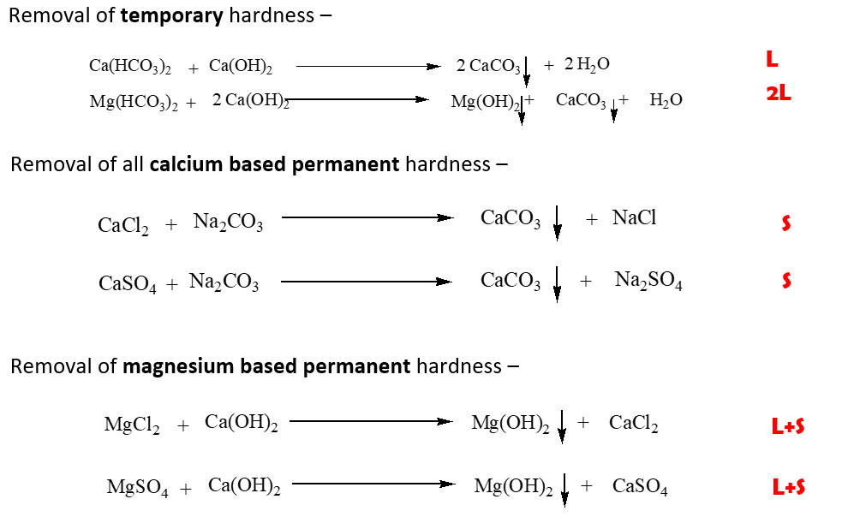
Q. Calculate the amount of lime and soda required for 18000 lit of a water sample which on analysis gave the following data:
Temporary Ca hardness = 25 ppm, Permanent Ca hardness = 20 ppm, Permanent Mg hardness = 15 ppm

Slide 75

Q. Calculate the amount of lime and soda required for 18000 lit of a water sample which on analysis gave the following data:
Temporary Ca hardness = 25 ppm, Permanent Ca hardness = 20 ppm, Permanent Mg hardness = 15 ppm

Slide 76

Calculations of the Requirement of Lime and Soda
Step 1. The units in which the impurities are analyzed and expressed are to be noted.
Step 2. Substances which do not contribute towards hardness (KCl, NaCl, SiO₂, Na₂SO₄ etc.) should be ignored and explicitly stated.
Step 3. A substance causing "hardness should be converted into their respective CaCO₃ equivalents.
CaCO₃ equivalent of hardness causing impurity
= $\frac{100}{2} ×chemical equivalent of impurity×weight of impurity$
$=multipliction factor×weight of impurity$
Notes.
If the impurities are given as Ca(HCO₃)₂ and Mg(HCO₃)₂ , they must only be expressed in terms of CaCO_{3.}
The amount expressed as CaCO₃ does not require any further conversion.
However, the amount expressed as MgCO₃ should be converted into its CaCO₃ equivalents by multiplying with 100/84

Slide 77

Calculations of the Requirement of Lime and Soda
Step 4: The amount of lime and soda required are calculated as follows.
Lime = $\frac{74}{100}$ {Temp Ca²⁺ hardness
+ (2 × Temp Mg²⁺ hardness)
+ Perm Mg²⁺ hardness + CO₂
+ HCl + H₂SO₄+ HCO–₃
+ salts of Fe²⁺ + 3 × salts of Al³⁺
– NaAlO₂}
Soda = $\frac{106}{100}$ {Perm Ca²⁺ hardness
+ Perm Mg²⁺ hardness
+ salts of Fe²⁺+ 3 × salts of Al³⁺
+ HCl + H₂SO₄ + HCO–₃
– NaAlO₂}
Note. If Ca²⁺ and Mg²⁺ is given,
1 equivalent of lime and 1 equivalent of soda is required for Mg²⁺
1 equivalent of soda is required for Ca²⁺.
The ions Ca²⁺ and Mg²⁺ are treated as permanent hardness due to Ca and Mg.

Slide 78
Calculations of the Requirement of Lime and Soda
Step 5. If the lime and soda used are impure and if the percentage purity is given, then the actual requirements of the chemicals should be calculated accordingly.
Thus, if lime is 90% pure, then the value obtained in step (6) must be multiplied by 100/90 to get actual lime requirement.
Similarly, if the soda is 95% pure then the value obtained in step (6) is multiplied by 100/95 to get actual soda requirement.
Lime/soda = value obtained from step 4 × (100 / % purity)
Step 6. The value obtained in step (6) is also multiplied by the volume of water which has to be purified.
Thus, the final formula for calculating the amount of lime or soda required is given as
Lime/soda = value obtained from step 5 × volume of water in liter × (100 / % purity)

Slide 79

Problem
Q. A water sample have the following impurities : Ca²⁺ = 20ppm; Mg²⁺ = 18 ppm; HCO₃⁻ = 183 ppm; SO₄²⁻ = 24 ppm. Calculate the amount of lime and soda needed for softening.
Lime required for softening:
74
[ Temp. Ca²⁺ + 2×Temp. Mg²⁺ + Perm. (Mg²⁺ + Fe²⁺ + Al³⁺)
+ CO₂ + H⁺ (HCl or H₂SO₄) + HCO₃⁻]
=
100
Soda required for softening:
106
[ Perm. (Ca²⁺ + Mg²⁺ + Fe²⁺ + Al³⁺) + H⁺ (HCl or
H₂SO₄) - HCO₃⁻]
=
100

Slide 80
Practice Problems
Q. A water sample on analysis gave the following data:
Ca²⁺ = 30 mg/L; Mg²⁺ = 24 mg/L; CO₂ = 24mg/L; K⁺ = 10 mg/L
Calculate the quantities of lime (90%) and soda (94%) required to soften one million liters of water sample.
Q. Explain with chemical equation and calculate the amount of lime and soda needed for softening 1,00,000 liters of water containing following:
HCl = 7.3 mg/L; Al₂(SO₄)₃ = 34.2 mg/L; MgCl₂ = 9.5 mg/L; NaCl = 29.25 mg/L
Purity of lime is 90% and that of the soda is 98%.
MW: Ca(HCO₃)₂=162; Mg(HCO₃)₂=146; CaSO₄=136; MgSO₄=120; MgCl₂=95; Al₂(SO₄)₃= 114

Slide 81

Practice Problems

Slide 82


Slide 83





Slide 84


Slide 85


Slide 86



Slide 87


Slide 88



Slide 89


Slide 90


Slide 91


Slide 92



Slide 93


Slide 94



Slide 95


Slide 96


Slide 97


Slide 99

Problem: How much NaCl is required to regenerate zeolite bed?
An exhausted zeolite softener was recovered using $x$ lit of $y$ gm/L NaCl solution. How much water having hardness of $z$ ppm can be softened using this bed?
A zeolite softener was used to remove the hardness of $x$ litres of hard-water completely. The softener required $y$ litres of NaCl solution containing $z$ g/litre of NaCl for regeneration. Calculate the hardness in ppm.
Amount of NaCl present in V₂ (gm)
Equivalent wt. of CaCO₃
Volume of NaCl solution used for regeneration
Hardness $=\frac{50}{58.5}×m×{10}^{3}×\frac{V_{2}}{V_{1}}$
Equivalent wt. of NaCl
Total vol. of water softened

Slide 100
Water softening
Removal of hardness –
Hardness is …
Primarily Ca, Mg
and Fe, Mn, St, Al salts
Ions like Na⁺/K⁺/NH₄⁺ do NOT cause hardness
How do we remove hardness?
Ion exchange of Ca/Mg with ions H⁺/OH⁻ → Ion exchange resin process
Ion exchange of Ca/Mg with Na → Zeolite process
Precipitation of Ca and Mg → Soda-Lime process

Slide 101


A typical problem
A zeolite softener was used to remove the hardness of 10000 litres of hard-water completely. The softener required 200 litres of NaCl solution containing 150 g/litre of NaCl for regeneration. Calculate the hardness in ppm.

Slide 102
A typical problem
An exhausted zeolite softener was recovered using 150 lit of 150 gm/L NaCl solution. How much water having hardness of 500 ppm can be softened using this bed?

Slide 103
A typical problem
A zeolite softener was used to remove the hardness of 95000 litres of hard-water completely. The softener required 475 litres of NaCl solution containing 18 g/litre of NaCl for regeneration. Calculate the hardness in ppm.

